Slide 1
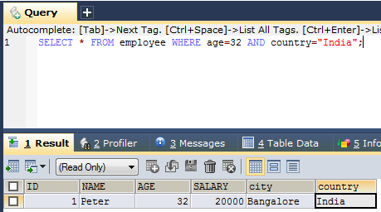
SQL AND Operator
The WHERE clause can be combined with AND, OR, and NOT operators.
The AND operator is used to filter records based on more than one condition. The AND operator displays a record if all the conditions separated by AND are TRUE
SELECT * FROM employee WHERE age=32 AND country="India“;
SELECT column1, column2, ... FROM table_name WHERE condition1 AND condition2 AND condition3 ...;

